Slide 1

Mobile Marketing

Slide 2
Mobile Marketing
Paid
Paid form of mobile marketing involves the buying of mobile media avenues.
Includes text, messaging provided by the telecom services, call services, audio availble in the waiting lines of inbound and outbound calls made by consumers, WAP portals, mobile websites etc.

Slide 3
Mobile Marketing
POE Framework
Paid
Text Ads | Voice | Display | Video
Owned
Brand Mobile sites | Content | Applications | Campaign Property
Earned
Interactions |  | Advocacy
Conversations Referrals |  | Loyalty Program Users

Slide 4
Mobile Marketing
Paid forms
Text | Voice | Display | Video
Push SMS Tag Fosters USSD String | OBD CRBT AdRBT Mobile Radio Railway Enquiry | WAP In-APP Rich Media Native Ads | Video Pre-rolls Ad as Content

Slide 5
Mobile Marketing
Owned
Marketers can also create their own mobile media spaces.
  Mobile Websites
    Responsive sites
    Best practices for mobile website
  Mobile Application
    Best practices for mobile App Design
    Mobile App Marketing

Slide 6
Mobile Marketing
Features
Location Based services or Proximity Marketing
Social Marketing on Mobile
QR Codes
Augmented Reality
Gamification

Slide 7
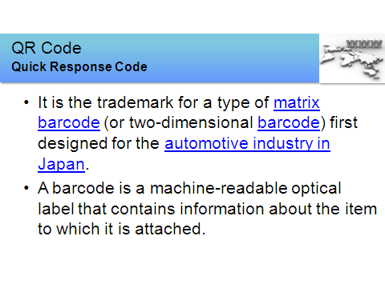

Slide 8
Video Caselet
Best Use of Mobile Media Wheel One Missed Call – YouTube
Question
Discuss the strategy of mobile marketing wrt target audience, startegies etc.

